Slide 1
SVRF Layout Analyzer tool
By: Mohamed Akl IC Design Engineer

Slide 2

AGENDA
Project Overview
Key Objectives
Layout Analysis Specification Summary
Project Structure and File Descriptions
How to use this project
Example 1: Run through the setup.sh
Example 2: Run through the GUI
Example 3: Run through regression_runner.sh
Reports
Testing

Slide 3
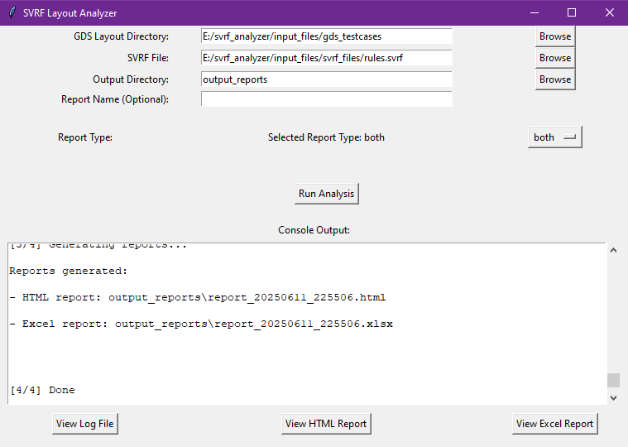
Project overview
The SVRF Layout Analysis Tool is a Python-based framework designed to validate Design Rule Check (DRC) test patterns in GDSII layout files using rules defined in SVRF (Standard Verification Rule Format).
​
It automates the process of checking whether test cases in a layout correctly pass or fail DRC rules, based on the layout geometry and DRC error markers.

Slide 4
Key Objectives
Parse SVRF rule files to extract rule names and comments.
Analyze layout geometries from GDS files (test cases).
Validate if each pattern behaves as expected (pass/fail).
Report the analysis results in HTML and Excel formats.

Slide 5
Layout Analysis Specification Summary
Category | Specification
Case Classification | - Good Cases: x > 0 (Right side of layout) - Bad Cases: x < 0 (Left side of layout)
Rule Grouping | - Covered with marker on Layer 255.1
Pattern Marking | - Each case pattern marked on Layer 255
Pass Criteria | - Good Cases: Must NOT have marker 0.1 inside error location Layer 0 - Bad Cases: Must have marker 0.1 inside error location Layer 0
Rule Names | - Written in Text Layer 22.22

Slide 6
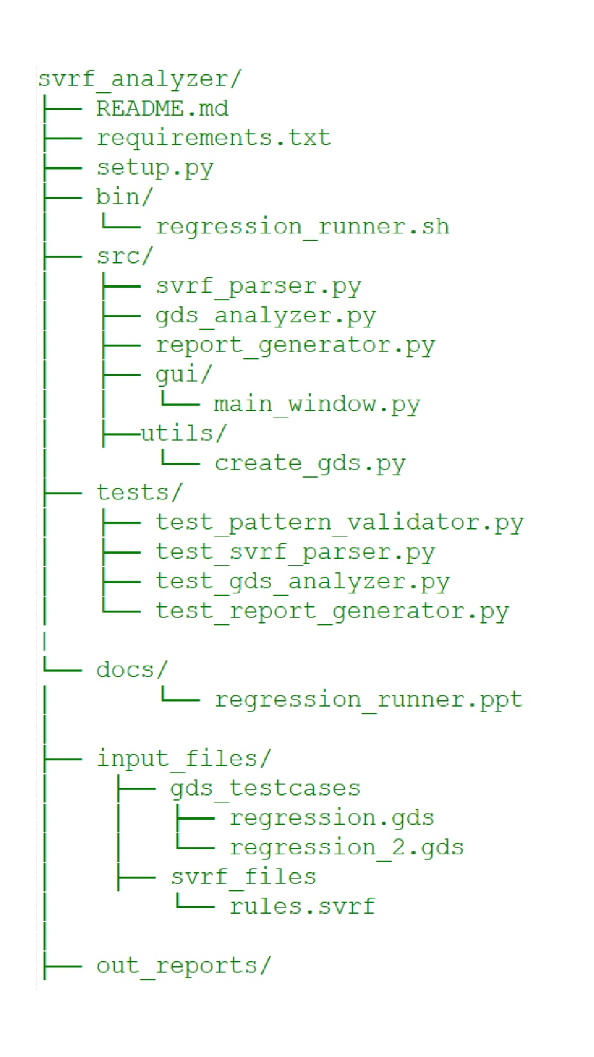

Project Structure & File Descriptions
setup.py: Main entry point
src/svrf_parser.py: Parses .svrf files
src/gds_analyzer.py: Read .gds layout files
src/pattern_validator.py: Contains logic to determine if a pattern passes or fails
src/report_generator.py: Generates HTML, and Excel reports
tests/: Contains unit tests for the source code
requirements.txt: Required packages

Slide 7
How to use this project
1. Install Requirements
pip install -r requirements.txt
2. Command Line
python setup.py --layout_dir ./input_files/gds_testcases --svrf_file ./input_files/svrf_files/rules.svrf --output_dir ./out_reports --report_type both
3. GUI Mode
python setup.py --gui
4. Shell Script
regression_runner.sh

Slide 8
Example 1: run through the setup.sh

Slide 9

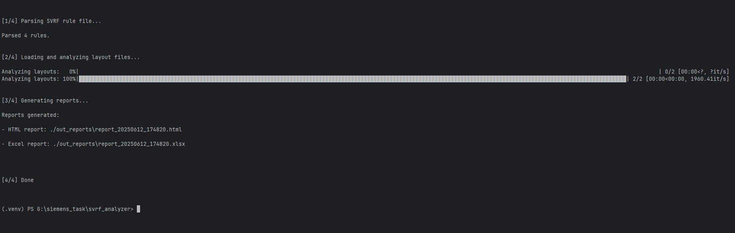
Before running any of the examples below, make sure to install the required dependencies:
pip install -r requirements.txt

Slide 10

You can execute the script directly using the Python CLI. This is useful for automated workflows or if you prefer terminal-based execution.
python setup.py --layout_dir ./input_files/gds_testcases --svrf_file ./input_files/svrf_files/rules.svrf --output_dir ./out_reports --report_type both
Explanation of Arguments:
--layout_dir
Specifies the directory containing input GDS test cases or layout files. These are
the designs to be analyzed.
--SVRF_file
Path to the SVRF rule file (rules.svrf) containing design validation rules and
constraints.
--output_dir
Directory where the generated reports will be saved. This folder will be created if it
doesn't exist.

Slide 11
You can execute the script directly using the Python CLI. This is useful for automated workflows or if you prefer terminal-based execution.
python setup.py --layout_dir ./input_files/gds_testcases --svrf_file ./input_files/svrf_files/rules.svrf --output_dir ./out_reports --report_type both
Explanation of Arguments:
--report_type
(Optional) Specifies the format(s) of the output report. Available options
include:
html: Generates an HTML report.
excel: Generates a Excel report.
both: Generates both HTML and Excel reports.
Default value is both
--report_name
(Optional) Allowing the user to specify a custom name for the
output report (HTML and Excel formats). Otherwise, Name will be
determined by the script.

Slide 12
What to Expect:
A progress bar will be displayed in the terminal showing task completion status.
The terminal will log the type of report being generated (HTML, Excel, or both).
The full paths to the output reports will be printed at the end.

Slide 13
Example 2: run through the GUI

Slide 14
Before running any of the examples below, make sure to install the required dependencies:
pip install -r requirements.txt

Slide 15
You can execute the script directly using the Python CLI
python setup.py --gui
Explanation of The GUI:
GDS Layout Directory
Path to the directory containing input GDS test cases or layout files. These are the designs to be analyzed.
You can use the Browse button to navigate to the directory instead of writing the path manually.
SVRF File
Path to the SVRF-style rule file (rules.svrf) containing design validation rules and constraints.
You can use the Browse button to select the file instead of typing the file path manually.
Output Directory
Directory where the generated reports will be saved. This folder will be created if it doesn't exist.
Click Browse to choose the directory without needing to type the path manually.
Report Type
Drop down list specifies the format(s) of the output report. Available options include:
html: Generates an HTML report.
excel: Generates a Excel report.
both: Generates both HTML and Excel reports. (Default)

Slide 16
You can execute the script directly using the Python CLI
python setup.py --gui
Explanation of The GUI:
Console Output
The console window provides real-time feedback during report generation.
It includes the following features:
A progress bar displaying the current status of the task.
Log messages indicating the type of report being generated (HTML, Excel, or both).
Full file paths to the generated reports are printed upon completion.
View Log File
Click this button to open the log file that captures all messages and output
written to the console window during execution. This allows you to review the
full runtime details in one place. This button will be disabled (greyed out) if no
log file is available.

Slide 17
You can execute the script directly using the Python CLI
python setup.py --gui
Explanation of The GUI:
View HTML Report
Click to open the generated HTML report. This button will be disabled (greyed out)
if no report is available.
View Excel Report
Click to open the generated Excel report. The button will be disabled (greyed out)
if no Excel report is available.
Report Name
(Optional) A text box allowing the user to specify a custom name for the output
report (HTML and Excel formats). If left blank, the report will be automatically
named using the format: report_<date>_<time>.

Slide 18
What to Expect
A graphical user interface will appear where you can:
Select the layout directory and rules file.
Write the output report name (Optional)
Choose the output format.
Start processing with the click of a button.
Progress and output status will be displayed within the GUI.
The HTML and Excel reports are generated in the output directory.
A log file capturing all console output generated during the analysis run is saved in the output directory.
You don't need to navigate to the report directory manually — you can open the log file, HTML report, and Excel report directly from the GUI by clicking the corresponding 'View Log File', 'View HTML Report', or 'View Excel Report' buttons
Each button will be disabled (grayed out) if the corresponding report does not exist. Additionally, a message will be displayed in the console indicating that the report is missing.

Slide 19
Example 3: run through regression_runner.sh

Slide 20

For a more convenient or repeatable workflow, you can use the regression_runner.sh bash script:
To run it from anywhere:
Add the script’s directory to your PATH:
export PATH=$PATH:/path/to/regression_runner.sh_directory
(Optional) Add it to your shell profile (~/.bashrc, ~/.zshrc, etc.) to make it permanent:
echo 'export PATH=$PATH:/path/to/your/script_directory' >> ~/.bashrc
source ~/.bashrc
Use the regression_runner.sh script with the same parameters as setup.py:
regression_runner.sh --layout_dir ./input_files/gds_testcases --svrf_file ./input_files/svrf_files/rules.svrf --output_dir ./out_reports --report_type both

Slide 21
For a more convenient or repeatable workflow, you can use the regression_runner.sh bash script:
regression_runner.sh --layout_dir ./input_files/gds_testcases --svrf_file ./input_files/svrf_files/rules.svrf --output_dir ./out_reports --report_type both
Explanation of Arguments:
--layout_dir
Specifies the directory containing input GDS test cases or layout files. These are
the designs to be analyzed.
--SVRF_file
Path to the SVRF-style rule file (rules.svrf) containing design validation rules
and constraints.
--output_dir
Directory where the generated reports will be saved. This folder will be
created if it doesn't exist.

Slide 22
For a more convenient or repeatable workflow, you can use the regression_runner.sh bash script:
regression_runner.sh --layout_dir ./input_files/gds_testcases --svrf_file ./input_files/svrf_files/rules.svrf --output_dir ./out_reports --report_type both
Explanation of Arguments:
--report_type
Specifies the format(s) of the output report. Available options include:
html: Generates an HTML report.
excel: Generates a Excel report.
both: Generates both HTML and Excel reports. (Default)
--report_name
(Optional) Allowing the user to specify a custom name for the
output report (HTML and Excel formats). Otherwise, Name will be
determined by the script.

Slide 23
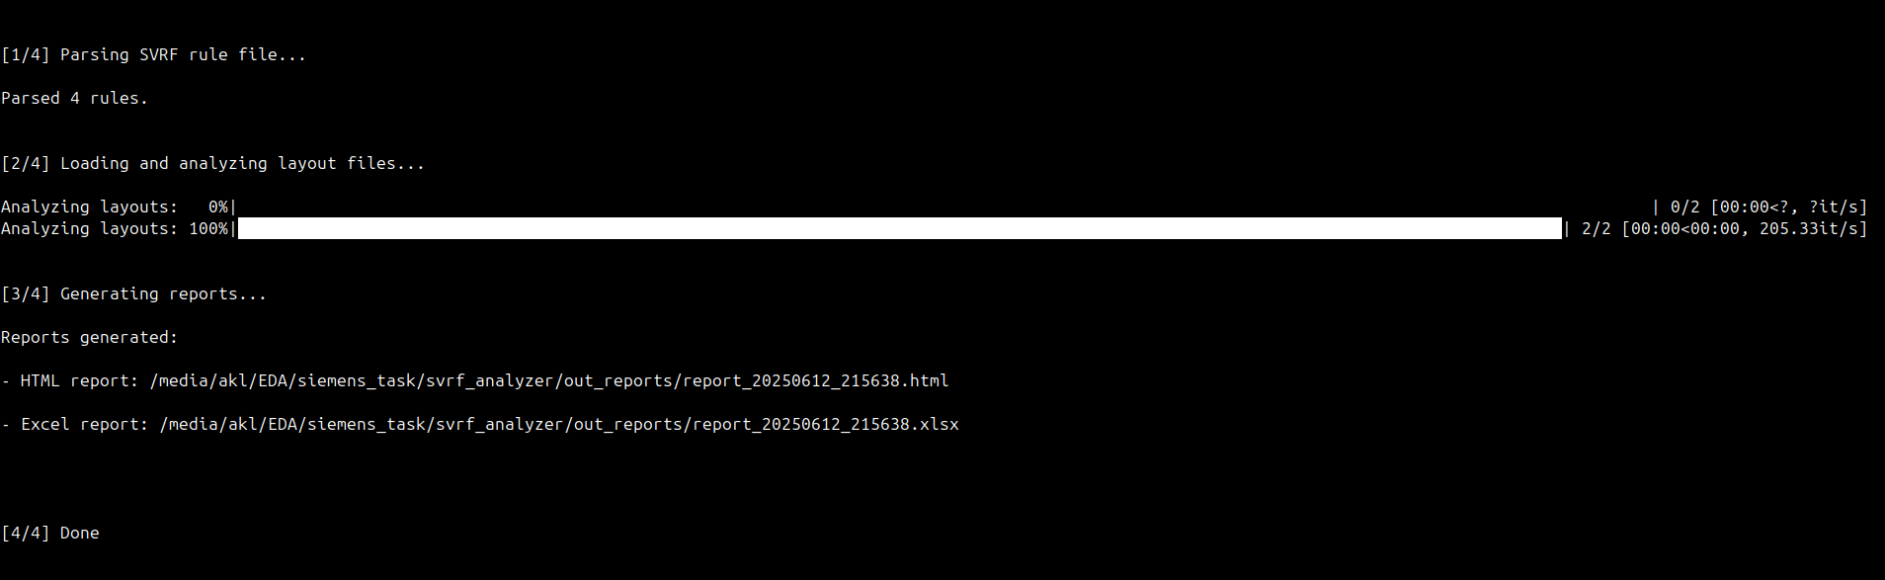
What to Expect:
Performs the same actions as the CLI mode.
A progress bar will be displayed in the terminal showing task completion status.
The terminal will log the type of report being generated (HTML, Excel, or both).
The full paths to the output reports will be printed at the end.

Slide 24

Reports

Slide 25



The script generates comprehensive reports in HTML and Excel formats, capturing both summary and detailed information related to layout pattern checks.
Summary Information (in both HTML and Excel):
Host Name – System where the report was generated
Timestamp – Date and time of report generation
Input Files Used – List of layout files or inputs analyzed
Overall Status – Pass/Fail status summarizing the entire analysis
Detailed Analysis:
Per Rule Metrics:
Count of Good and Bad patterns
Count of Passed and Failed patterns (categorized by Good/Bad)
Rule Comments – Descriptions or justifications related to each rule
Failure Pattern Details:
Layout Path
Cell Name – For easy traceability within input layouts

Slide 26

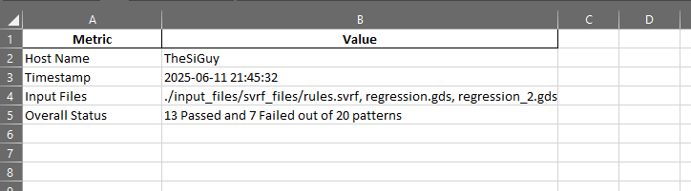
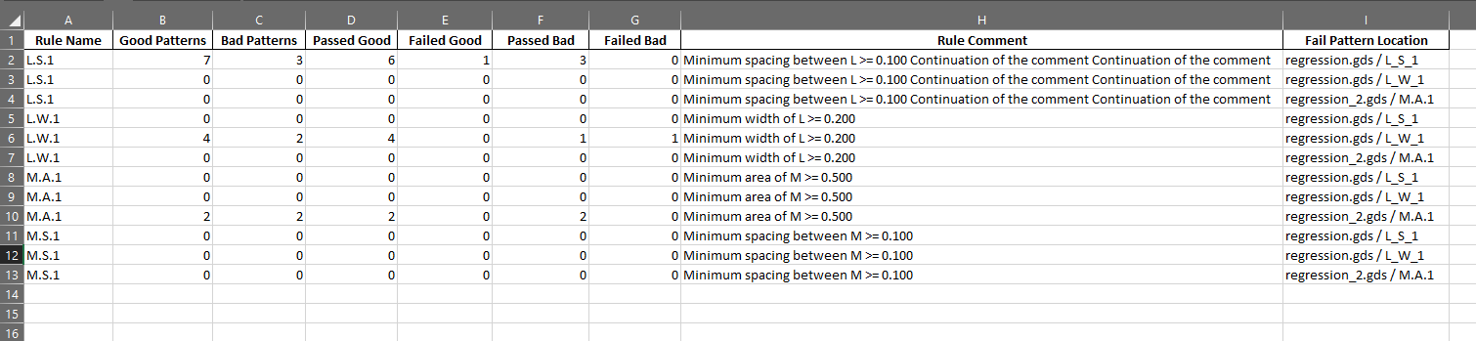
Excel Report
Excel Report Contains:
Summary Sheet – Contains overall report information and high-level metrics
Individual Result Sheets – One sheet per input layout showing rule-wise analysis and failure details
.

Slide 27

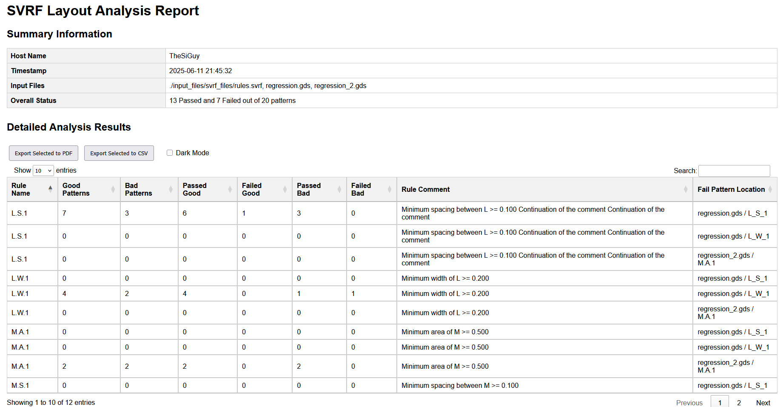
Interactive HTML Report
JavaScript-powered Tables:
Paginated results for ease of navigation
Individual result selection via checkboxes.
PDF Export – Allows exporting selected rows as a printable PDF
CSV Export – Allows exporting selected rows as a printable PDF
Dark Mode_Toggleable night mode via checkbox

Slide 28

Testing

Slide 29

Testing
To validate the implementation, unit tests are provided in the ./tests directory. These tests cover the core functionality of the reporting system.
How to Run Tests:
python -m unittest discover tests
Test Files Overview:
test_gds_analyzer.py
Tests the gds_analyzer.py functions
test_pattern_validator.py
Tests the pattern_validator.py functions
test_report_generator.py
Tests HTML report generation

Slide 30
Testing
To validate the implementation, unit tests are provided in the ./tests directory. These tests cover the core functionality of the reporting system.
How to Run Tests:
python -m unittest discover tests
Test Files Overview:
test_svrf_parser.py
Tests SVRF parsing functionality.
./src/utils/ create_gds.py
Used in tests files to create test layout cells
Code snippets from the SVRF rule file are contained within the test_svrf_parser.py file

Slide 31
Thank you

Slide 32

Contact
Mohamed Akl
IC Design Engineer
Mobile +201091012175
E-mail: mohamed.akl@thesiguy.com
Website: www.thesiguy.com
YouTube: www.youtube.com/@TheSiGuyEN
GitHub: www.github.com/TheSiGuy

